Slide 1
House
5 czerwiec

Slide 2
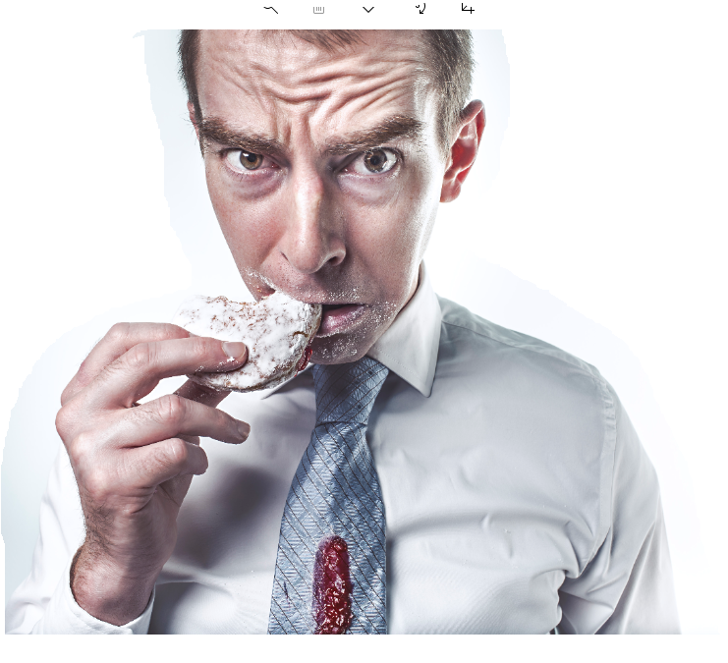
Where is daddy? Źródła zdjęć: www. Jestrudo.pl, imcreator.com, unsplash.com

Slide 3
Daddy is in the bedroom
sypialnia

Slide 4
Where is grandpa??

Slide 5
He is in the kitchen !
Kitchen - kuchnia

Slide 6
Where is my brother?

Slide 7
My brother is in the living room
Living room - salon

Slide 8
Where is my dog?

Slide 9
My dog is in the garden
Garden - ogród

